Slide 1
Pattern Recognition
Probability Distributions

Slide 2
Content
CH 02
Introduction
Beta Distribution

Slide 3

Introduction
Bernoulli distribution: $Bern(x|μ) = μ^{x}{\left(1 − μ\right)}^{1−x}$
Mean $E[x] = μ$
Variance $var[x] = μ(1 − μ)$
Maximum likelihood estimator (sample mean) $μ_{ML} =\frac{1}{N}\sum_{n=1}^{N}{x_{n}}=\frac{m}{N}$

Slide 4

Introduction
Binomial distribution $Bin\left(m | N,μ\right)=\left({N \atop m}\right)μ^{m}{\left(1−μ\right)}^{N−m}$
Mean $E\left[m\right]=Nμ$
Variance $Nμ\left(1−μ\right)$
Maximum likelihood estimator (sample mean) $μ_{ML} =\frac{m}{N}$

Slide 5

Introduction
The maximum likelihood setting for the parameter $μ$ in the Bernoulli and binomial distributions is given by the fraction of the observations in the data set having $x = 1$.
This causes over-fitting for small data sets.
We solve this problem by using a Bayesian approach
Introducing a prior distribution $P(μ)$ for parameter $μ$

Slide 6

Beta Distribution
We choose a prior, called the beta distribution $Beta\left(μ | a,b\right)=\frac{Γ\left(a+b\right)}{Γ\left(a\right)+Γ\left(b\right)}μ^{a−1}{\left(1−μ\right)}^{b−1}$
$Γ(x)$ is the gamma function (an extension of the factorial function to the real numbers)
Mean $E\left[μ\right]=\frac{a}{a + b}$
Variance $var\left[μ\right]=\frac{ab}{{\left(a+b\right)}^{2}\left(a+b+1\right)}$
The parameters $a, b$ are hyperparameters to control the distribution of $μ$

Slide 7
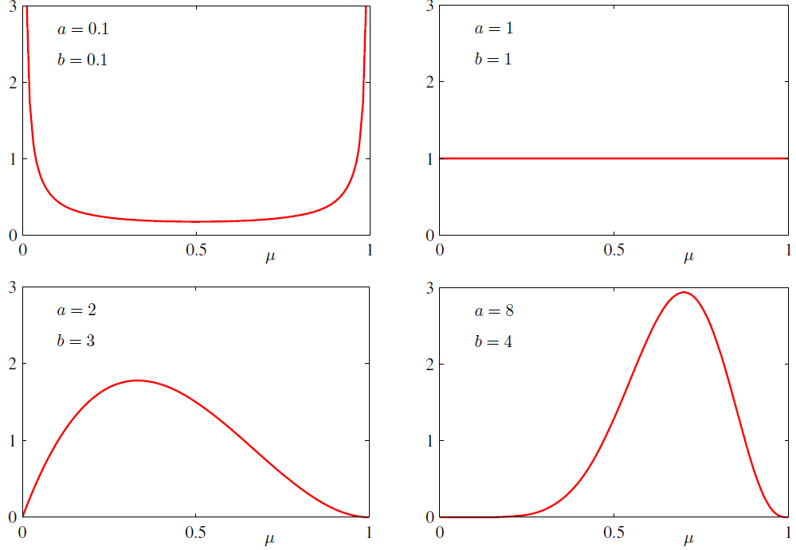

Beta Distribution
Plots of the beta distribution $Beta(μ|a, b)$ as a function of $μ$ for various values of the hyperparameters a and b.

Slide 8

Beta Distribution
The posterior distribution of $μ$ is now obtained by multiplying the beta prior by the binomial likelihood function $p(μ|m, l, a, b) ∝ μ^{m+a−1}{\left(1 − μ\right)}^{l+b−1}$
$a, b$ are hyperparameters
$μ$ is the sample mean (maximum likelihood estimator)
$l=N−m$, corresponds to the complement of the value we predict (number of ‘tails’ or 0s in the coin example)

Slide 9

Beta Distribution
The Beta distribution provides the conjugate prior for the Bernoulli distribution. $p\left(μ ∣ m,l,a,b\right)=\frac{Γ\left(m+a+l+b\right)}{Γ\left(m+a\right)Γ\left(l+b\right)}μ^{\left(m+a−1\right)}{\left(1−μ\right)}^{l+b−1}$

Slide 10
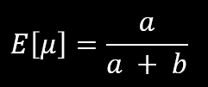
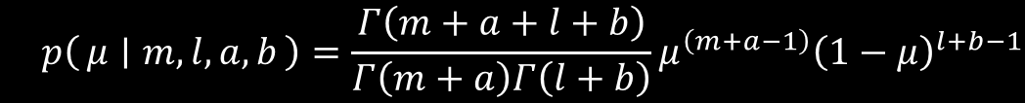


Beta Distribution
Now the predictive distribution is given by combining the:
$$p(x = 1|D) =\frac{m + a}{m + a + l + b}$$
Mean of the Beta distribution
The posterior distribution of $μ$

Slide 11
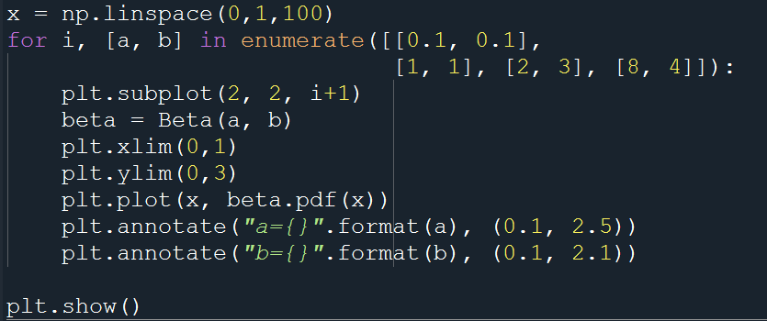
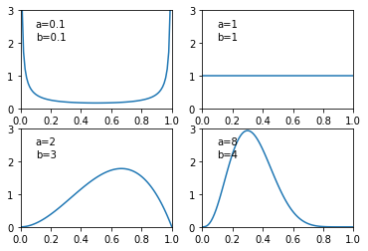

Beta Distribution
Plot the Beta distribution for different values of $a, b$:
$a,b = [0.1, 0.1], [1, 1], [2, 3], [8, 4]$

Slide 12
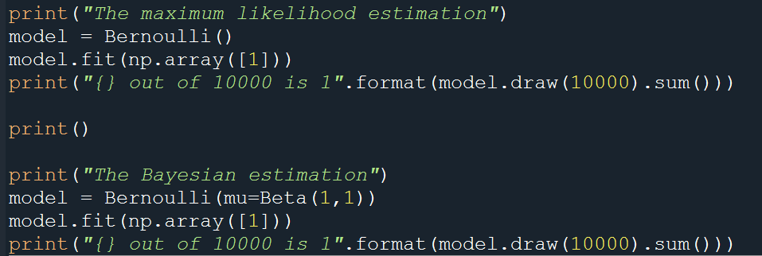

Beta Distribution
Let’s test the Bernoulli distribution using Maximum likelihood estimator and the Bernoulli distribution using Bayesian estimation (Beta distribution)
Try different values for $a, b$ for the beta distribution

